Slide 1
Parallel Sorting Algorithms

Slide 2
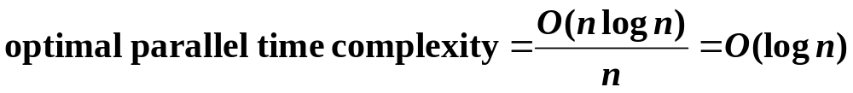
Potential Speedup
O(nlogn) optimal sequential sorting algorithm
Best we can expect based upon a sequential sorting algorithm using n processors is:

Slide 3
Compare-and-Exchange
Sorting Algorithms
Form the basis of several, if not most, classical sequential sorting algorithms.
Two numbers, say A and B, are compared between P₀ and P₁.
P₀
P₁
A
B
MIN
MAX

Slide 4
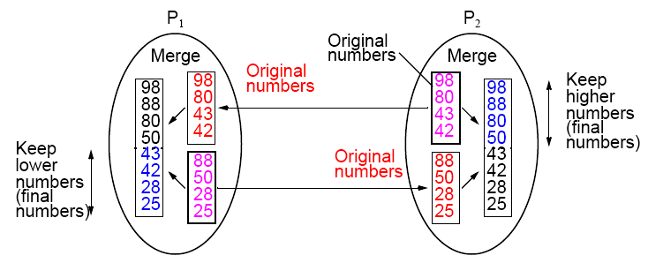
Compare-and-Exchange Two Sublists

Slide 5
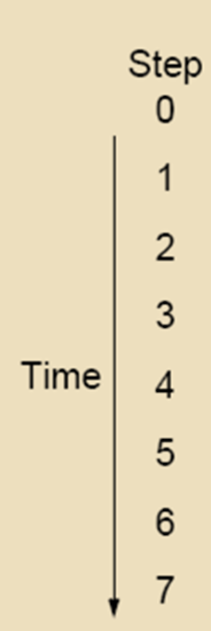
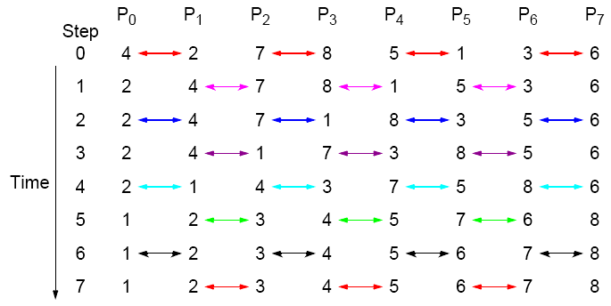
Odd-Even Transposition Sort - example
Parallel time complexity: T_{par} = O(n) (for P=n)

Slide 6
Odd-Even Transposition Sort – Example (N >> P)
Each PE gets n/p numbers. First, PEs sort n/p locally, then they run
odd-even trans. algorithm each time doing a merge-split for 2n/p numbers.
P₀ P₁ P₂ P₃
13 7 12 8 5 4 6 1 3 9 2 10
Local sort
7 12 13 4 5 8 1 3 6 2 9 10
O-E
4 5 7 8 12 13 1 2 3 6 9 10
E-O
4 5 7 1 2 3 8 12 13 6 9 10
O-E
1 2 3 4 5 7 6 8 9 10 12 13
E-O
SORTED: 1 2 3 4 5 6 7 8 9 10 12 13
Time complexity: T_{par} = (Local Sort) + (p merge-splits) +(p exchanges)
T_{par} = (n/p)log(n/p) + p*(n/p) + p*(n/p) = (n/p)log(n/p) + 2n

Slide 7
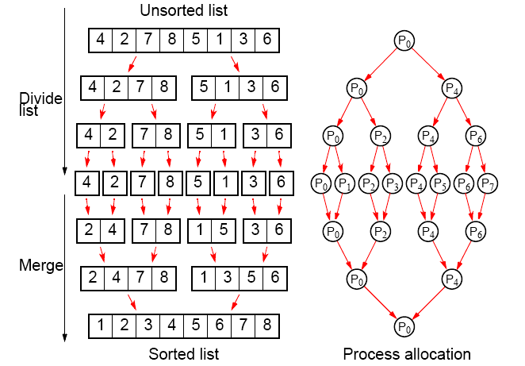
Parallelizing Mergesort

Slide 8
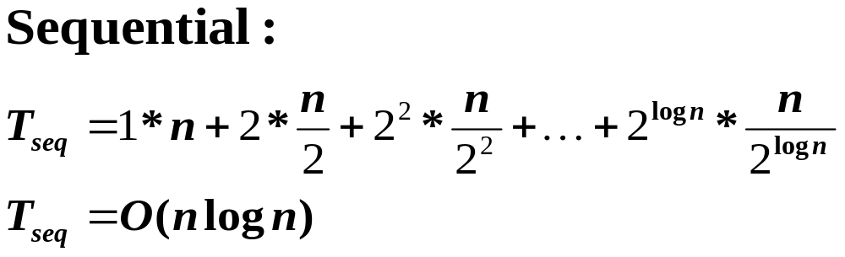
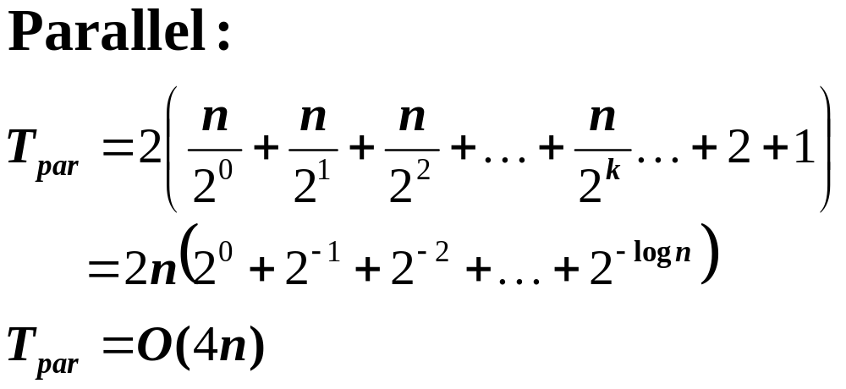
Mergesort - Time complexity

Slide 9
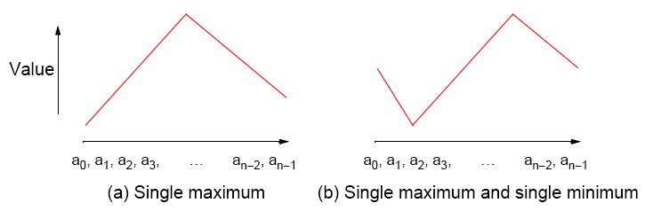
Bitonic Mergesort
Bitonic Sequence
A bitonic sequence is defined as a list with no more than one LOCAL MAXIMUM and no more than one LOCAL MINIMUM.
(Endpoints must be considered - wraparound )

Slide 10

A bitonic sequence is a list with no more than one LOCAL MAXIMUM and no more than one LOCAL MINIMUM.
(Endpoints must be considered - wraparound )
This is ok!
1 Local MAX; 1 Local MIN
The list is bitonic!
This is NOT bitonic! Why?
1 Local MAX; 2 Local MINs

Slide 11
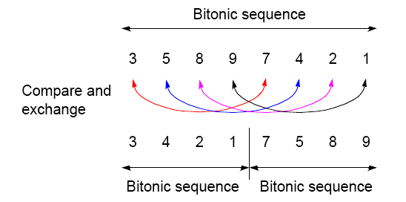
Binary Split
Divide the bitonic list into two equal halves.
Compare-Exchange each item on the first half
with the corresponding item in the second half.
Result:
Two bitonic sequences where the numbers in one sequence are all less than the numbers in the other sequence.

Slide 12
Repeated application of binary split
Bitonic list:
24 20 15 9 4 2 5 8 | 10 11 12 13 22 30 32 45
Result after Binary-split:
10 11 12 9 4 2 5 8 | 24 20 15 13 22 30 32 45
If you keep applying the BINARY-SPLIT to each half repeatedly, you
will get a SORTED LIST !
10 11 12 9 . 4 2 5 8 | 24 20 15 13 . 22 30 32 45
4 2 . 5 8 10 11 . 12 9 | 22 20 . 15 13 24 30 . 32 45
4 . 2 5 . 8 10 . 9 12 .11 15 . 13 22 . 20 24 . 30 32 . 45
2 4 5 8 9 10 11 12 13 15 20 22 24 30 32 45
Q: How many parallel steps does it take to sort ?
A: log n

Slide 13
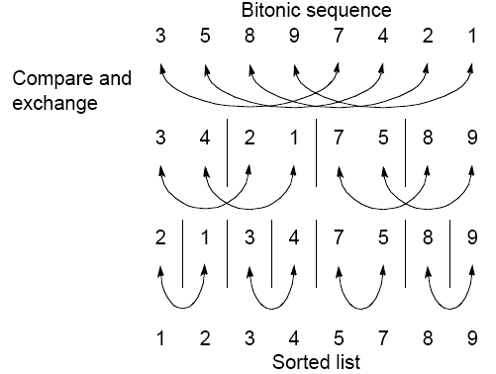
Sorting a bitonic sequence
Compare-and-exchange moves smaller numbers of each pair to left and larger numbers of pair to right.
Given a bitonic sequence,
recursively performing ‘binary split’ will sort the list.

Slide 14
Sorting an arbitrary sequence
To sort an unordered sequence, sequences are merged into larger bitonic sequences, starting with pairs of adjacent numbers.
By a compare-and-exchange operation, pairs of adjacent numbers formed into increasing sequences and decreasing sequences. Pairs form a bitonic sequence of twice the size of each original sequences.
By repeating this process, bitonic sequences of larger and larger lengths obtained.
In the final step, a single bitonic sequence sorted into a single increasing sequence.

Slide 15

Bitonic Sort
Step No.
1
2
3
4
5
6
Processor No.
000 001 010 011 100 101 110 111
L
H
H
L
L
H
H
L
L
L
H
H
H
H
L
L
L
H
L
H
H
L
H
L
L
L
L
L
H
H
H
H
L
L
H
H
L
L
H
H
L
H
L
H
L
H
L
H
Figure 2: Six phases of Bitonic Sort on a hypercube of dimension 3

Slide 16
Bitonic sort (for N = P)
P₀ P₁ P₂ P₃ P₄ P₅ P₆ P₇
000 001 010 011 100 101 110 111
K G J M C A N F
Lo Hi Hi Lo Lo Hi High Low
G K M J A C N F
L L H H H H L L
G J M K N F A C
L H L H H L H L
G J K M N F C A
L L L L H H H H
G F C A N J K M
L L H H L L H H
C A G F K J N M
A C F G J K M N

Slide 17
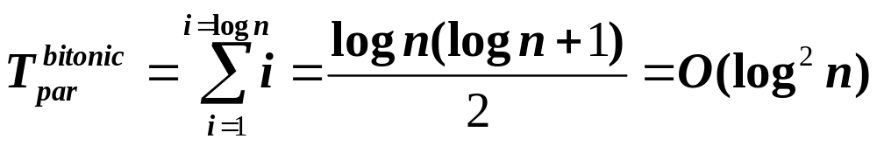
Number of steps (P=n)
In general, with n = 2^{k}, there are k phases, each of 1, 2, 3, …, k steps.
Hence the total number of steps is:

Slide 18
Bitonic sort (for N >> P)
x x x x
x x x x
x x x x
x x x x
x x x x
x x x x
x x x x
x x x x

Slide 19
P₀ P₁ P₂ P₃ P₄ P₅ P₆ P₇
000 001 010 011 100 101 110 111
2 7 4 13 6 9 4 18 5 12 1 7 6 3 14 11 6 8 4 10 5 2 15 17
Local Sort (ascending):
2 4 7 6 9 13 4 5 18 1 7 12 3 6 14 6 8 11 4 5 10 2 15 17
L H H L L H High Low
2 4 6 7 9 13 7 12 18 1 4 5 3 6 6 8 11 14 10 15 17 2 4 5
L L H H H H L L
2 4 6 1 4 5 7 12 18 7 9 13 10 15 17 8 11 14 3 6 6 2 4 5
L H L H H L H L
1 2 4 4 5 6 7 7 9 12 13 18 14 15 17 8 10 11 5 6 6 2 3 4
L L L L H H H H
1 2 4 4 5 6 5 6 6 2 3 4 14 15 17 8 10 11 7 7 9 12 13 18
L L H H L L H H
1 2 4 2 3 4 5 6 6 4 5 6 7 7 9 8 10 11 14 15 17 12 13 18
L H L H L H L H
1 2 2 3 4 4 4 5 5 6 6 6 7 7 8 9 10 11 12 13 14 15 17 18
Bitonic sort (for N >> P)

Slide 20
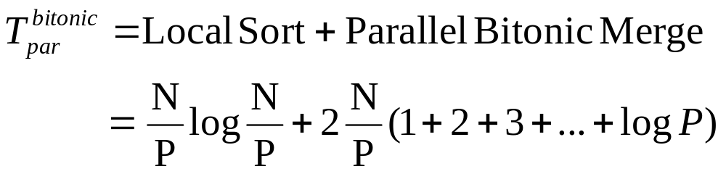
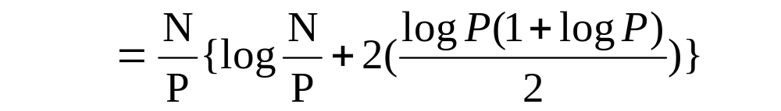
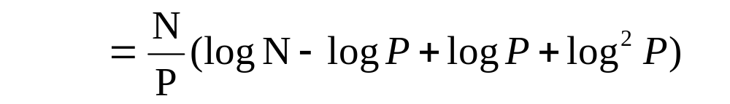
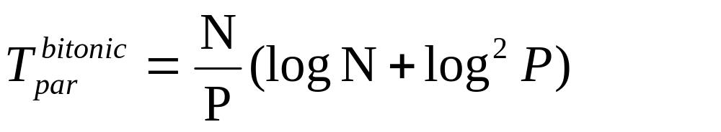
Number of steps (for N >> P)

Slide 21
Parallel sorting - summary
Computational time complexity using P=n processors
Odd-even transposition sort - O(n)
Parallel mergesort - O(n)
unbalanced processor load and Communication
Bitonic Mergesort - O(log²n) (** BEST! **)
Parallel Shearsort - O(√n logn) (* covered later *)
Parallel Rank sort - O(n) (for P=n) (* covered later *)

Slide 22
Sorting on Specific Networks
Two network structures have received special attention:
mesh and hypercube
Parallel computers have been built with these networks.
However, it is of less interest nowadays because networks got faster and clusters became a viable option.
Besides, network architecture is often hidden from the user.
MPI provides libraries for mapping algorithms onto meshes, and one can always use a mesh or hypercube algorithm even if the underlying architecture is not one of them.

Slide 23
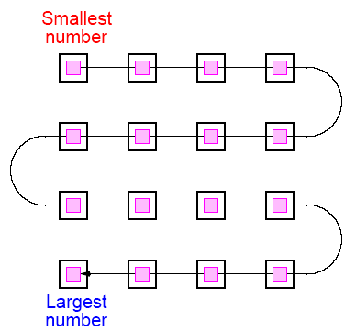
Two-Dimensional Sorting on a Mesh
The layout of a sorted sequence on a mesh could be row by row or snakelike:

Slide 24
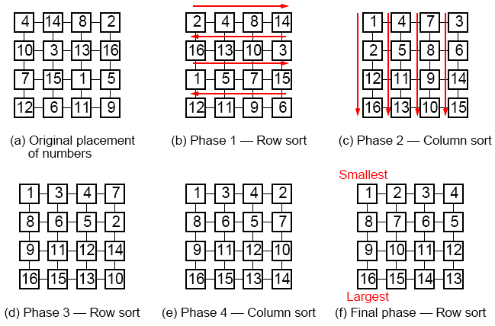
Shearsort
Alternate row and column sorting until list is fully sorted.
Alternate row directions to get snake-like sorting:

Slide 25
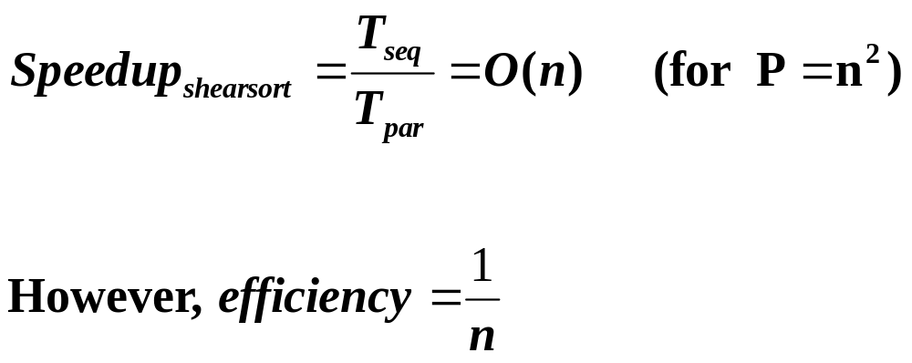
Shearsort – Time complexity
On a n x n Mesh, it takes 2log n phases to sort n² numbers.
Therefore:
Since sorting n² numbers sequentially takes T_{seq} = O(n² log n);

Slide 26
Rank Sort
Number of elements that are smaller than each selected element is counted. This count provides the position of the selected number, its “rank” in the sorted list.
First a[0] is read and compared with each of the other numbers, a[1] … a[n-1], recording the number of elements less than a[0].
Suppose this number is x. This is the index of a[0] in the final sorted list.
The number a[0] is copied into the final sorted list b[0] … b[n-1], at location b[x]. Actions repeated with the other numbers.
Overall sequential time complexity of rank sort: T_{seq} = O(n²)
(not a good sequential sorting algorithm!)

Slide 27
Sequential code
for (i = 0; i < n; i++) { /* for each number */
x = 0;
for (j = 0; j < n; j++) /* count number less than it */
if (a[i] > a[j]) x++;
b[x] = a[i]; /* copy number into correct place */
}
*This code needs to be fixed if duplicates exist in the sequence.
sequential time complexity of rank sort: T_{seq} = O(n²)

Slide 28
Parallel Rank Sort (P=n)
One number is assigned to each processor.
P_{i} finds the final index of a[i] in O(n) steps.
forall (i = 0; i < n; i++) { /* for each no. in parallel*/
x = 0;
for (j = 0; j < n; j++) /* count number less than it */
if (a[i] > a[j]) x++;
b[x] = a[i]; /* copy no. into correct place */
}
Parallel time complexity, O(n), as good as any sorting algorithm so far. Can do even better if we have more processors.
Parallel time complexity: T_{par} = O(n) (for P=n)

Slide 29
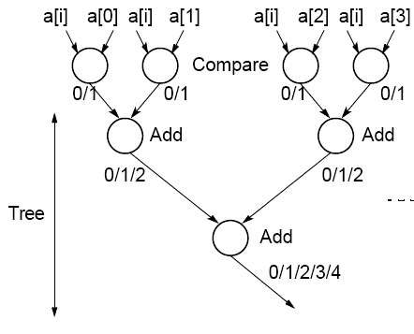
Parallel Rank Sort with P = n²
Use n processors to find the rank of one element. The final count, i.e. rank of a[i] can be obtained using a binary addition operation (global sum ➔ MPI_Reduce())
Time complexity
(for P=n²):
T_{par} = O(log n)
Can we do it in O(1) ?

